Slide 1


X
Sales Analysis
Nama Program VIX
Presented by
Rais Yufli Xavierullah

Slide 2



Rais Yufli Xavierullah
Experience
Entrepreneurship Assistant - Suku Dinas PPKUKM East Jakarta (2021 – 2023)
About You
Research and Development - Production System and Automation Laboratory Assistant (2018 – 2020)
Ex-Entrepreneurship Assistant transitioning into a Data Scientist role after completing Hacktiv8 Data Science Bootcamp. Over two years of experience in government I was in charge of helping entrepreneurs move up their class level by helping to develop legality and also training. Core skills include providing actionable insights from modeling and statistical analysis.
Engineer Staff Intern - Zi Argus (2019 – 2019)

Slide 3
Case Study
Bank Muamalat mempunyai data mengenai penjualan produk-produk pada tahun 2020 hingga 2021. Saya sebagai seorang Business Intelligence membantu dalam memberikan insight kepada perusahaan agar dapat mempertahankan ataupun menaikkan penjualan dari produk-produk yang ditawarkan.

Slide 4
Case 1
Masing-masing primary key pada 4 dataset penjualan
Tabel Customer :
Primary Key (PK): ` CustomerID`
Tabel Orders :
Primary Key (PK): `OrderID`
Foreign Key (FK): `CustomerID`
Foreign Key (FK): ` ProdNumber`
Tabel Product :
Primary Key (PK): `ProdNumber`
Foreign Key (FK): `CategoryID`
Tabel Category :
Primary Key (PK): ` CategoryID`

Slide 5
Case 2
Relationship dari ke-4 table tersebut
Tabel Orders memiliki relasi dengan Tabel Customer melalui kolom CustomerID
Tabel Orders memiliki relasi dengan Tabel Product melalui kolom ProdNumber
Tabel Product memiliki relasi dengan Tabel Category melalui kolom CategoryID

Slide 6
Case 3
SQL Query
CREATE TABLE rakamin.master_table AS
SELECT
o.date,
cat.categoryname,
p.prodname,
p.price,
o.quantity,
(o.quantity * p.price) AS total_sales,
c.customeremail,
c.customercity
FROM
rakamin.customers c
JOIN rakamin.orders o ON c.customerid = o.customerid
JOIN rakamin.product p ON o.prodnumber = p.prodnumber
JOIN rakamin.category cat ON p.category = cat.categoryid
ORDER BY o.date ASC;

Slide 7
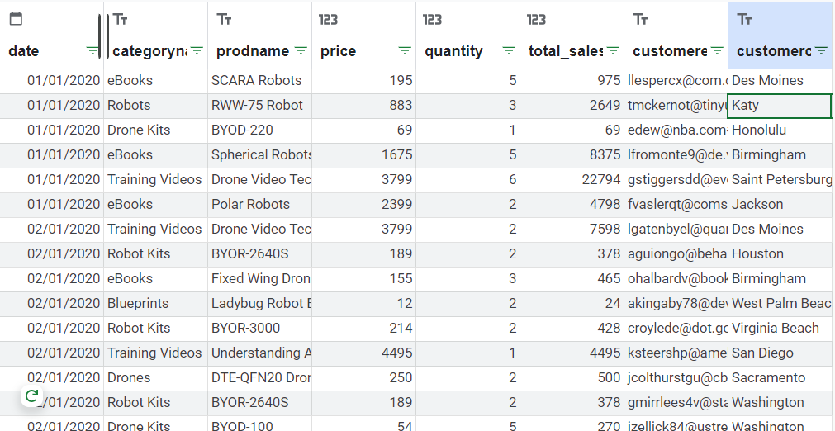
Case 3
Master Data
https://docs.google.com/spreadsheets/d/1jPaC2iQxMFtjAcnSgP806yAjEZQUMSik9N8ufGa6NmQ/edit?usp=sharing

Slide 8
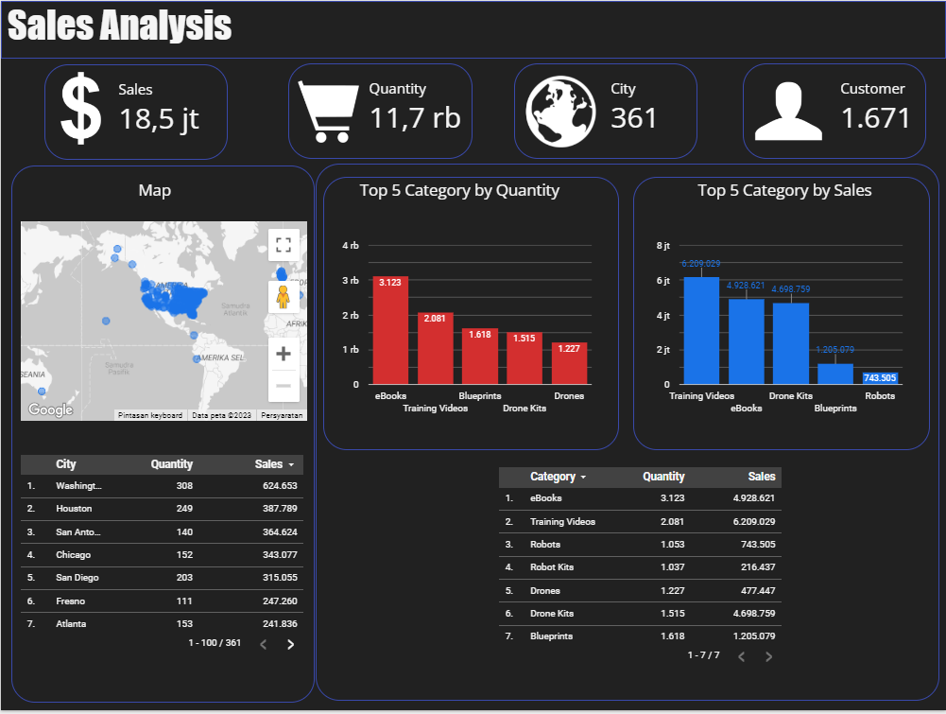
Case 4
Dashboard
https://lookerstudio.google.com/s/qT66t0zSfQU

Slide 9
Case 5
Insight
https://lookerstudio.google.com/s/qT66t0zSfQU

Slide 10
Insert Your Link Here
You can add link GitHub / Coda / Figma also (optional)

Slide 11
Video Presentation Here
Please insert your link video here (You can upload the video on YouTube or Google Drive first)!

Slide 12

Thank You
X
Logo Company

